Slide 1




Xamarin training
for mobile app development professionals
Oh, Hello!

Slide 2






Introducing the Mobile Customer Advisory Team
The team includes mobile architects and developers who are experts in mobile app development in general and Xamarin in particular.
Alex Blount
Sweeky Satpathy
Ben Buttigieg
Mike Parker
Dean Faizal
Alexey Strakh

Slide 3
Agenda for the training
Introductions
FUNdamentals
Development and Architecture
Write Once, Run Everywhere*
Xamarin.Forms

Slide 4
Resources
Stack Overflow
Use Stack Overflow for questions about error messages, API usage, and other implementation questions. http://stackoverflow.com/
Questions tagged with Xamarin: http://stackoverflow.com/questions/tagged/xamarin
Ask a new Xamarin question: http://stackoverflow.com/questions/ask?tags=xamarin
Xamarin Forums
Use Xamarin Forums for questions on the platform, roadmap, and other general concerns and conversations. https://forums.xamarin.com/
GitHub Issues
Use GitHub Issues to submit bug and issue reports for Xamarin products.
Bugzilla.xamarin.com
Use Bugzilla to search a read-only database of historical bug and issue reports for Xamarin products.

Slide 5
Complete setup (as necessary)

Slide 6
Confirm your setup
Set up MacBook or Mac Mini (or connect to MacStadium)
Install latest Visual Studio for Mac and Xcode
For details about setting up your Windows machine, see https://university.xamarin.com/resources/win-setup
Complete a custom installation of Visual Studio 2019
Xamarin
Android emulator
Download and install the NUnit Test Adapter 2.0
Within Visual Studio, click Tools, and then click Extensions and Updates.
In the Extensions and Updates dialog box, expand Online, search the Visual Studio Gallery for NUnit, and then click and download NUnit Test Adapter 2.0.

Slide 7
Confirm your setup, continued
Pair Windows with a Mac host for iOS development
Set up Mac to use as a build host
Set up Visual Studio to use your Mac as a build host
Other things:
iOS simulator on Mac
Plug in iOS device to Mac
Visual Studio Emulator for Android
Plug in Android device to Windows PC
Update Android SDKs
Troubleshoot Android installation (as needed)
Troubleshoot running the Android Emulator on newer Windows machines

Slide 8
Icebreaker

Slide 9
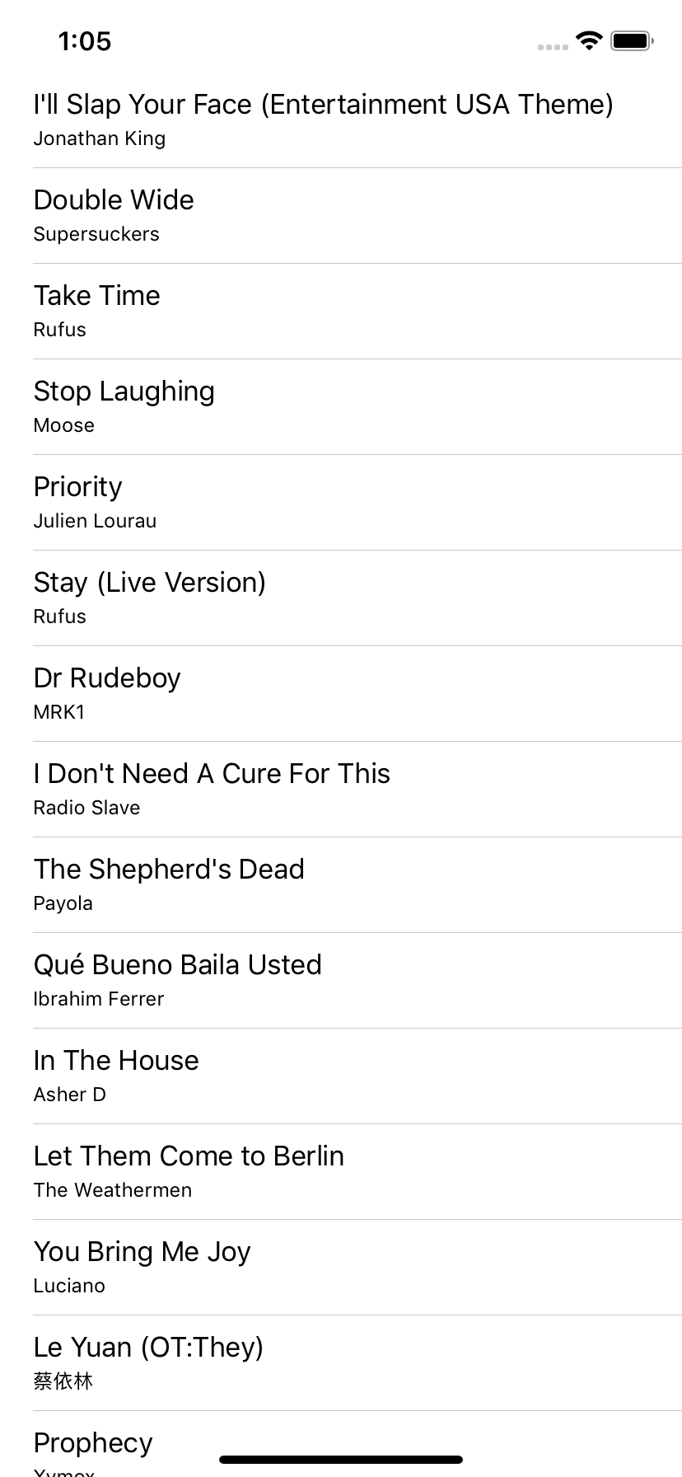
Coding exercise
Download data from the following url and display it in a list:
https://dl.dropboxusercontent.com/s/cv75h76pv9su7l4/songs-small.json
OR
https://bit.ly/2JY08gt
Notes:
The idea is get an understanding of how well you know the underlying platforms, and how fast you find answers to problems/issues you might not know how to address.
http://ullibility.net/wp-content/uploads/2014/09/xamagon-e1423564314550-300x270.png

